Slide 1
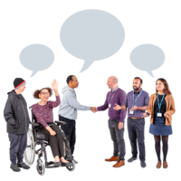



Access to Politics Charter

Slide 2

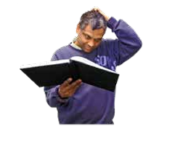
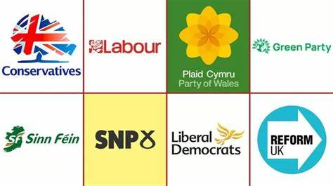

How to use this Document
This is an easy read document. You may still need support to read it. Ask someone you know to help you.
Words in bold blue writing may be hard to understand. You can check what these words mean on pages 19 and 20.
Where this document says we it means our political party.
Practice Solutions made this document into Easy Read using Photosymbols.

Slide 3
Contents
About Access to Politics Page 4
The Charter Points Page 6
Accessibility and inclusion Page 8
A disabled member's group Page 11
Disability equality training Page 12
Talking about disabilities Page 13
Everyone can be involved Page 14
Sharing information Page 15
Helping people to job-share Page 16
Working in politics Page 17
The social model of disability Page 18
Hard Words Page 19

Slide 4
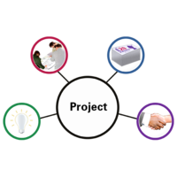


About Access to Politics
Access to Politics is a project for disabled people in Wales. The project wants to make sure that disabled people have the same chance as everyone else to be involved in politics.
This charter was written by the
Access to Politics Grassroots
Network Members. This is a group
for disabled people who are
interested in politics.
The Access to Politics Charter written by Inclusion Scotland was used to help write it. Disability Wales want to thank Inclusion Scotland for letting them use the charter.
The Welsh Government gave Disability Wales funding for the Access to Politics project. Disability Wales want to thank the Welsh Government for this money.

Slide 5
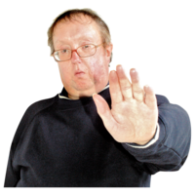
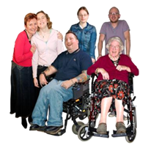
About Access to Politics
The charter is important because there are not many disabled people in politics in Wales.
This means that decisions that affect disabled people are made by people without lived experience of disability.
The charter shows what political parties can do and should do to involve disabled people in politics.
Disability Wales wants all political parties to use the Charter.

Slide 6
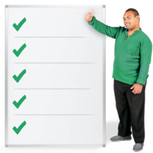

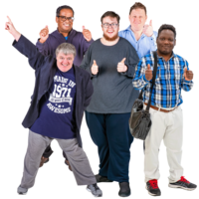
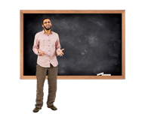

The Charter Points
This is a list of the important things written in this Charter. The rest of this document explains how we will make sure that these things happen.
We will write a statement that says how we will support disabled people to take part. This will be called our Accessibility and Inclusion Statement. We will publish that statement.
We will pay for a group for disabled members in our political party.
We will make sure that everyone has Disability Equality Training.
We will make sure that we use the Social Model of Disability when we talk about and think about disability.

Slide 7

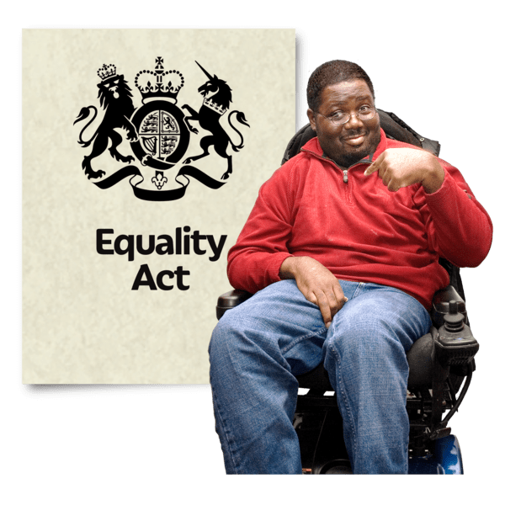
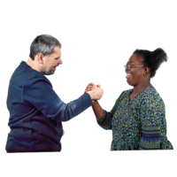
The Charter Points
We will make sure that everyone can be involved in our work. This means being accessible.
We will follow the Welsh Government’s Diversity and Inclusion Guidance. This means that we are choosing to share information about anyone who wants to be elected.
We will help people to job-share when they work for us or are elected to work with us.
We will help disabled people to have jobs in politics.
We will use the Social Model of Disability in the things that we do and say.

Slide 8
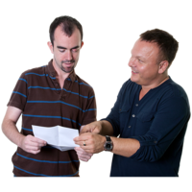
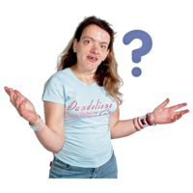


Accessibility and Inclusion Statement
We promise to support disabled people in politics.
We promise to listen to the things that get in the way of people being involved in politics, and we promise to change these things. We promise to be accessible, and we promise to provide support.
We will check the Accessibility and Inclusion Statement, and we will change it when we need to.
The rest of this section tells you how we will do this.
We promise to have accessibility and inclusion policies.
The policies will say clearly how we will make politics accessible. It will say what the rules are to make sure this happens.

Slide 9
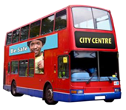

Accessibility and Inclusion Statement
The policies and rules can say things like this.
We will make sure that people can get to meeting and events on a bus or train, and that there are disabled parking spaces.
We will make sure that the places we use for meetings and events are in buildings that people can easily get in and out of and move around inside.
We will make sure that the signs we use are easy to read and give people the right information.
We will make sure that our information is accessible.
We will make sure that our staff and party members have had the right training. This means disability equality training as well as others.

Slide 10

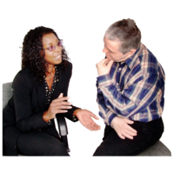
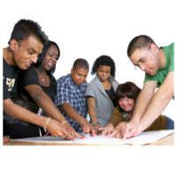
Accessibility and Inclusion Statement
As part of our accessibility and inclusion statement we promise to do these things.
We will make changes to our political party so that disabled people can join in. We will write an action plan that tells you how we will do this. We will check our action plan every year.
We will have Disability Equality Champions to advocate for disabled people. This will make sure that the party is getting better at supporting and including disabled people.
We will have an Accessibility Officer. This person will make sure that disabled people get the help they need.
We will have a party conference every year for disabled groups.
We will co-produce decisions with disabled people. We will hold meetings and working groups.
We will make sure that disabled people can speak to us and tell us about the things that they want to be done differently.

Slide 11
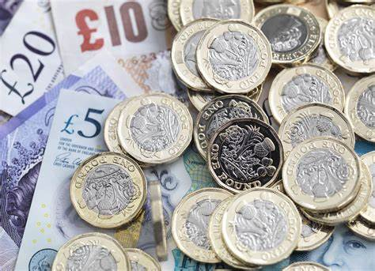
A Disabled Member's Group
We promise to help set up and pay for a Disabled Member's Group. We will do this to empower people.
We will ask people to join the Disabled Member's Group and to join our party. We will tell people about the Group and share Good News Stories.
We will ask the Group to help us make things better for disabled people. We will involve the Group from the beginning and co-produce our work.
We will help people to meet up at party conferences and events. We will meet up with other Groups and parties too so that we can change things.
We will help to pay for reasonable adjustments.

Slide 12
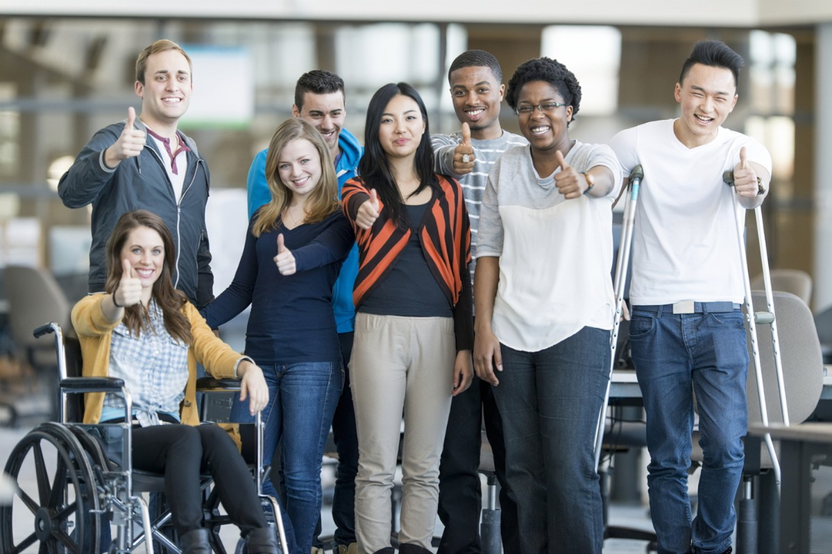

Disability Equality Training
We promise to make sure that the people in our party have disability equality training. We will make sure that people in our party have the right training for their jobs.
We will make sure that the training is co-produced. We think it is important that disabled people help to plan and do the training.
We will use the social model of disability. Our training will help people to see and stop discrimination.
We will do training to teach us how to get more disabled people and more young disabled people to take part in politics.
We will do training that will teach us how to use technology to help disabled people to take part in politics.

Slide 13
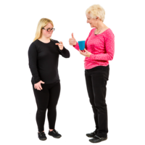
Talking about Disability
We will not talk about disability as medical conditions. We promise to use the social model of disability when we talk about disability.
We will make sure that our work is accessible. We will use Easy Read, videos and lots of other tools to help us with this. We will use the Disability Wales toolkit.
We will make sure that our meetings and events are accessible. We will make it easy for people to get to them.
We will make sure everyone in our party knows why reasonable adjustments are important and how they can help with this. We will make online training.
We will make sure that we use respectful words to talk to people.
Our leader will make sure we keep these promises.

Slide 14
Everyone can be Involved
We promise to make sure that everyone can be involved in politics.
We know that it can be difficult for people to come to events and meetings. We don't think that this should stop people from taking part. We want to make it easier for people to be involved.
We will use technology to help people take part and vote. We will ask for meetings to be hybrid. This means that people can join in person or by using technology.
We will help to pay for reasonable adjustments and technology so that people can do this.
We will make sure that the places we hold meetings and events are accessible. We will make sure they have the right technology for people to use.
We will change our rules so that we can do these things. We will ask other parties to do the same thing.

Slide 15

Sharing Information
We want to tell the public about the protected characteristics of people who want to be elected.
We think it can help to make sure that our party has lots of different people in it with different ideas.
We will ask people if we can share this information. We will only share the information that they say we can. We will make it easy for people to tell us this information.
We will collect and publish this information. We will do this without sharing anybody's names.
We will tell people why it is important and share Good News Stories about the difference it makes.

Slide 16
Helping People to Job-Share
We think that job-sharing is important. Job-sharing means that people who find it difficult to work all day, every day can still have a job.
We want to use job-sharing to make sure that lots of people can take part in politics. This will help us to hear more ideas and experiences.
We will look at Good News Stories from other places that already do job-sharing, like the Senedd.
We will use Equality Laws.
We will make sure that we think about how to make job-sharing work. We will put the right policies in place.

Slide 17
Working in Politics
We promise to help more disabled people work in politics. We think it is important.
The rest of this page tells you how we will do this.
We will make sure that people feel safe to tell us about their disabilities and the help they need. We will not force anyone to tell us about their disability.
We will share good news stories about the good work that disabled people already do in politics.
We will make sure everybody in the party does Disability Equality Training.
We will have teaching projects so that disabled people in politics can learn from each other.
We will support disabled people to manage their work.
We will ask young disabled people to get involved.

Slide 18
The Social Model of Disability
We believe that the Social Model of Disability is important. It shows us that disability happens because of the way the world works, not because of people's medical conditions.
We promise to use the Social Model of Disability in everything we do. We think it will help to make our communities better for everyone.
We will talk about disability in the right way. We will listen to what people say about how they want to be spoken to.
We will make sure that disabled people can join in with everything we do. We will start this now and plan it for the future.
We will learn from good news stories. We will listen to what people say.
We will put time and money into apprenticeships.

Slide 19
Hard Words
Politics – politics are the things that the government or political parties do to try to change the way their country works.
Charter – a charter is a document that has a set of ideas about how to do something well
Political Party or Political Parties – A political party is a group of people who believe the same things about how the country should work. They come together as a group to try to win elections.
Statement – A statement is when you describe something clearly in writing.
Accessibility and Inclusion Statement – An Accessibility and Inclusion Statement is when you write down how you will make sure that disabled people can be involved in something. It is like writing a promise.
Publish – When you publish something, you make sure that lots of people can read it.
Social Model of Disability – The Social Model of Disability is a way to think about disability. It shows how to include disabled people.
Accessible – When you make something accessible, you make sure that everybody can use or understand it.
Diversity and Inclusion Guidance – Welsh Government’s guide to make sure everyone is treated fairly.

Slide 20
Hard Words
Elected – People are elected when lots of other people vote for them because they think they will do a good job.​
Job-share – A job-share is when more than one person does the same job. They usually do the job on different days or at different times. ​
Policy or Policies – A policy is when a group of people agree to do things a certain way.​
Conference – A conference is a formal meeting. Sometimes they last for more than one day.​
Empower – This means to make someone stronger and more confident in themselves and their rights.​
Reasonable Adjustments – This is where the person you work for makes changes so that it is easier for a disabled person to go to work or to take part in something.​
Discrimination – Discrimination is when you treat people unfairly because of their disability, gender, race or other differences.​
Respectful – this means thinking about somebody’s feelings and rights, and being kind to them.​
Leader – A leader is someone who takes charge of a group. In politics, each party has a party leader.​
Hybrid – Hybrid means a mixture of two things. In our charter it means to mix spending time together in person and through technology.​

